Slide 1
Approaches
1.Reduce number of operations for storage/compute
--Network Pruning(weight and activations)
2.Reduce size of operands for storage/compute
--Floating point to Fixed point
--Bit-width reduction
3. Application Scenarios
--Hardware Architecture
--How Compressed algorithm’s used on Hardware?
Notes:
世界顶尖的…. 已获得亿级美元融资

Slide 2
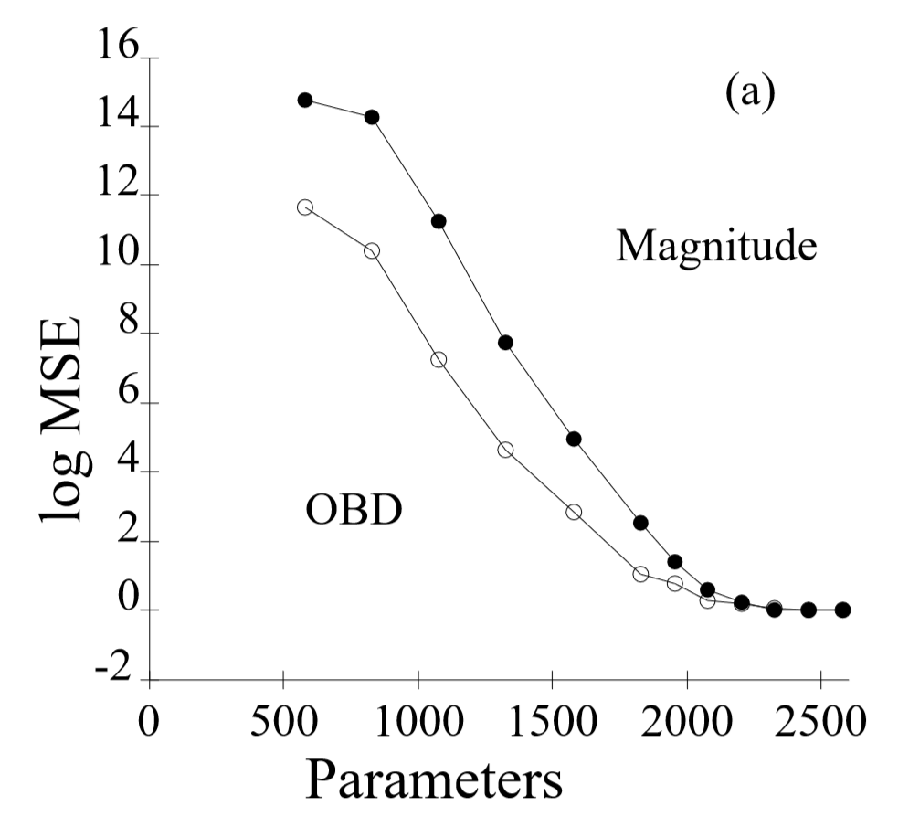
1.1Pruning – Make Weights Sparse
Method1： Optimal Brain Damage [Lecun et al., NIPS 1989]
Source:Lecun et al., NIPS 1989, Pattern classification.

Slide 3
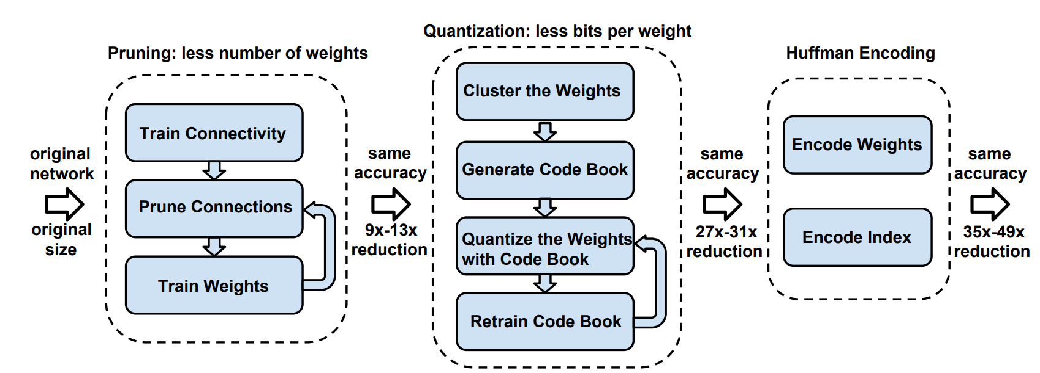
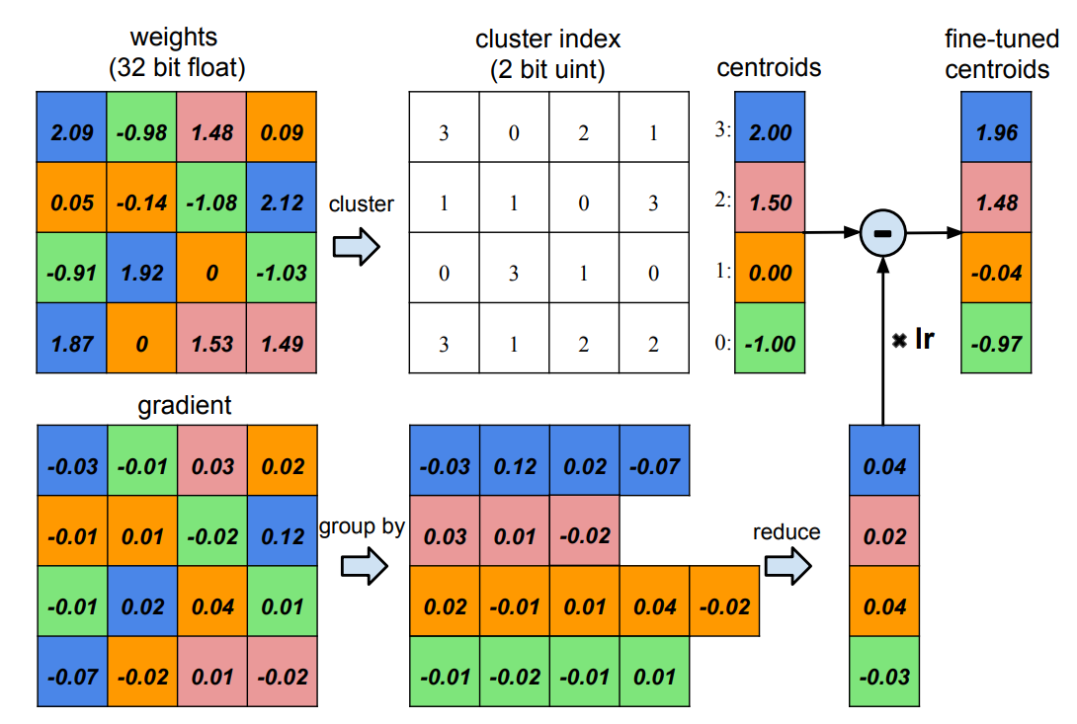
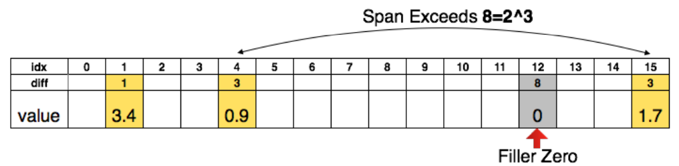
1.1Pruning – Make Weights Sparse
Method2：magnitude-based pruning methods
Three stage compression pipeline
quantization
Source: Deep compression by Song Han
Encoding method

Slide 4
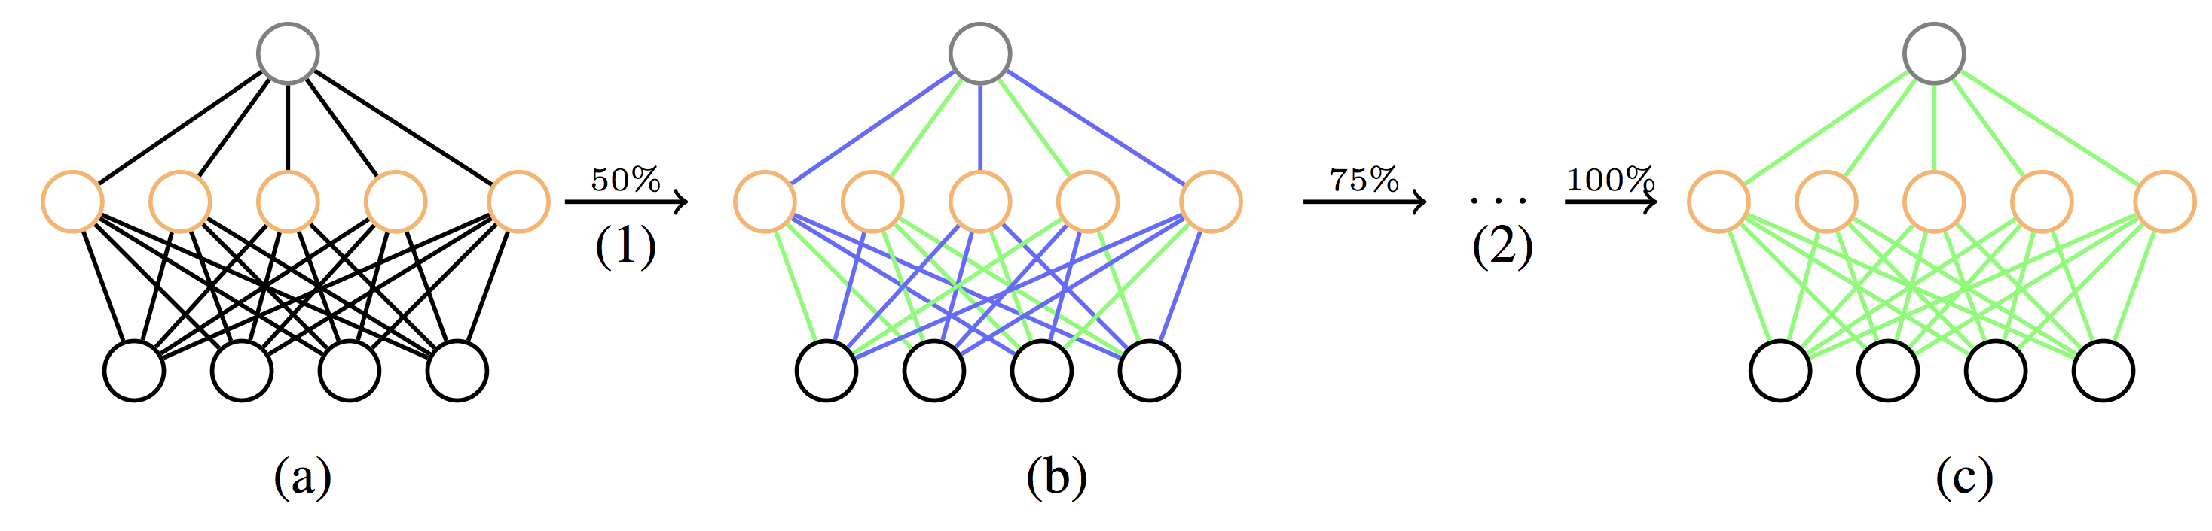
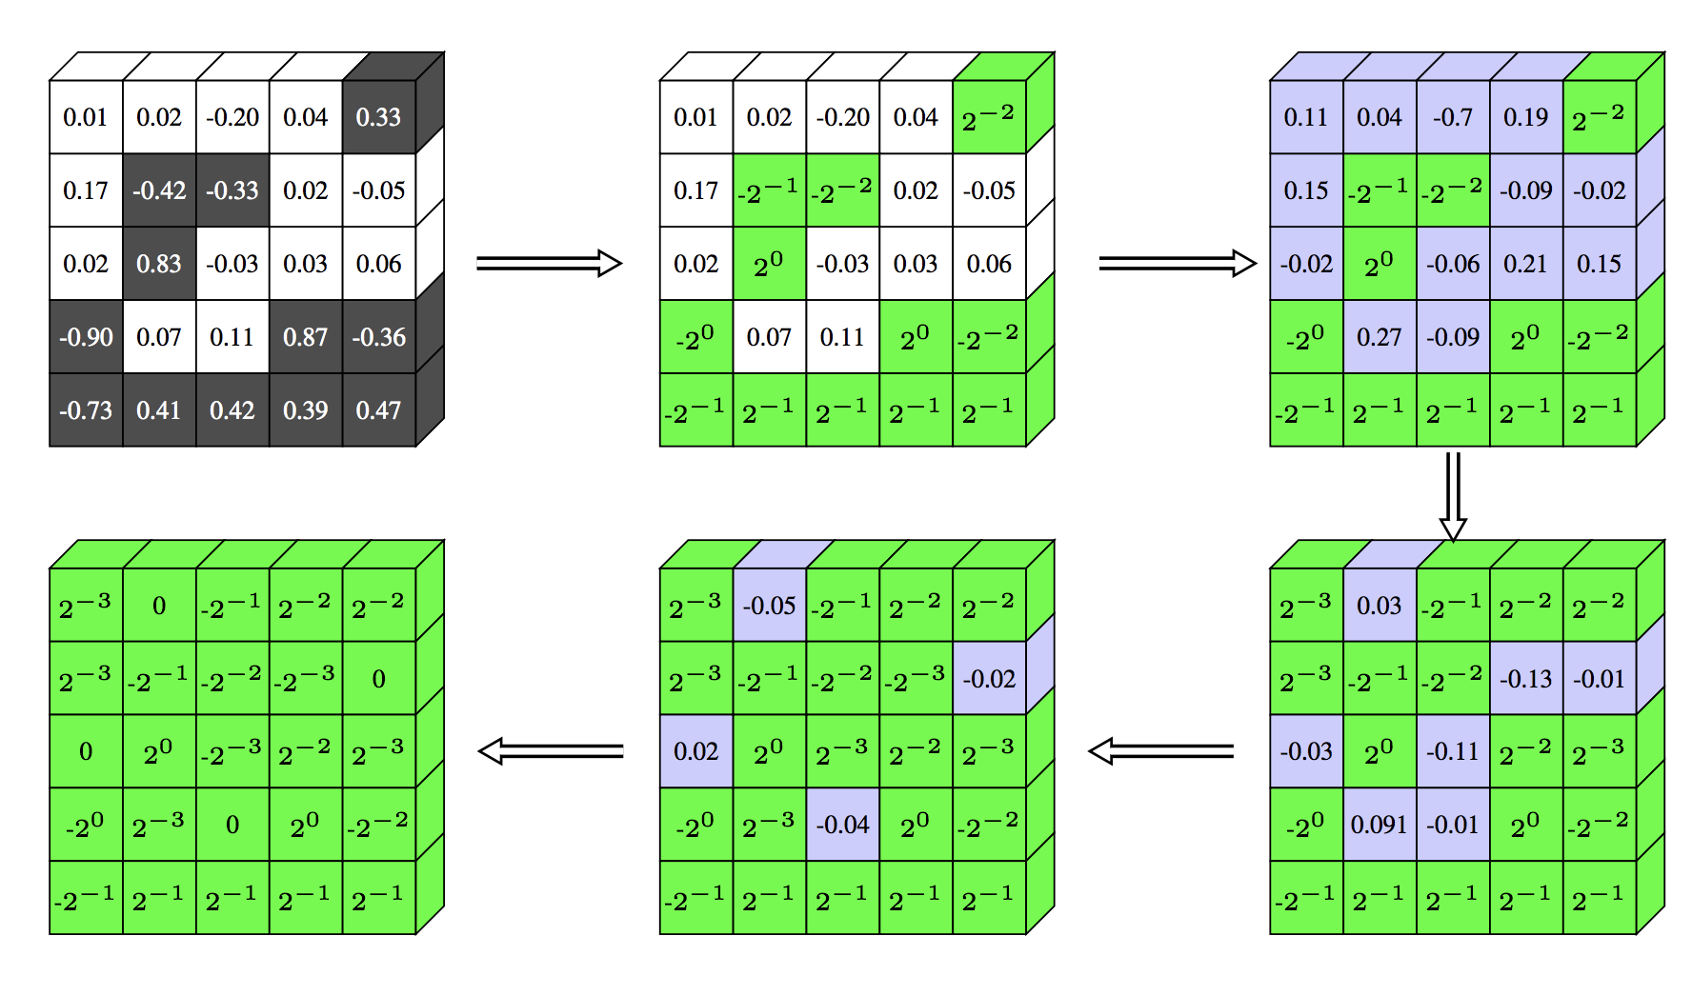
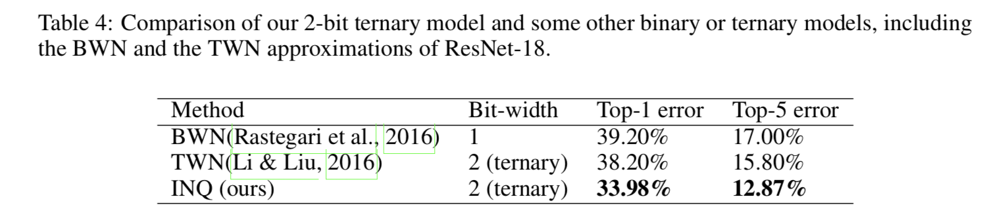
1.1 INQ
(1)先将每个kernel的数据分为2个组，一组量化编码另一组保持不变，(2)再使用训练集去训练这个模型直到收敛。(3)再把之前已量化编码的数据固定住，把之前没有量化编码的数据分为两组，一组量化编码，一组保持不变，(4)继续使用训练集来训练，直至模型收敛。
(5)重复上述操作，把kernel中的所有的权重都编码量化了，则认为模型已压缩。
Notes:
世界顶尖的…. 已获得亿级美元融资

Slide 5
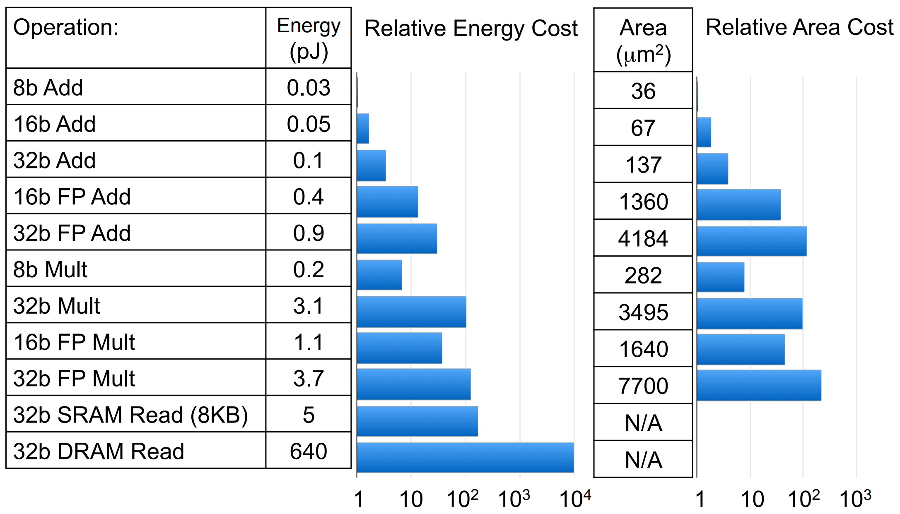
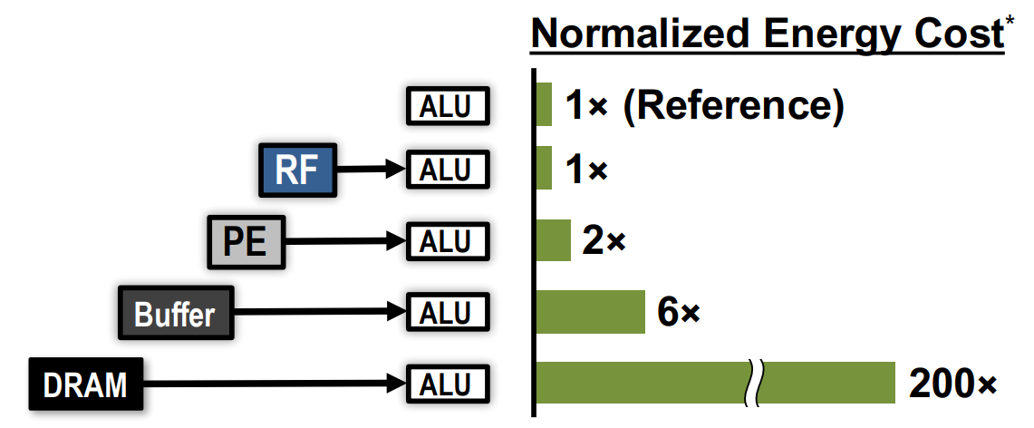
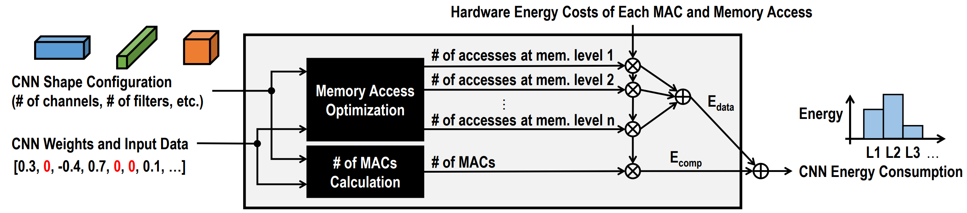
1.1Pruning – Make Weights Sparse
Method3：Energy-Aware Pruning
Macs consumption
Memory consumption
Calculation of energy consumption

Slide 6
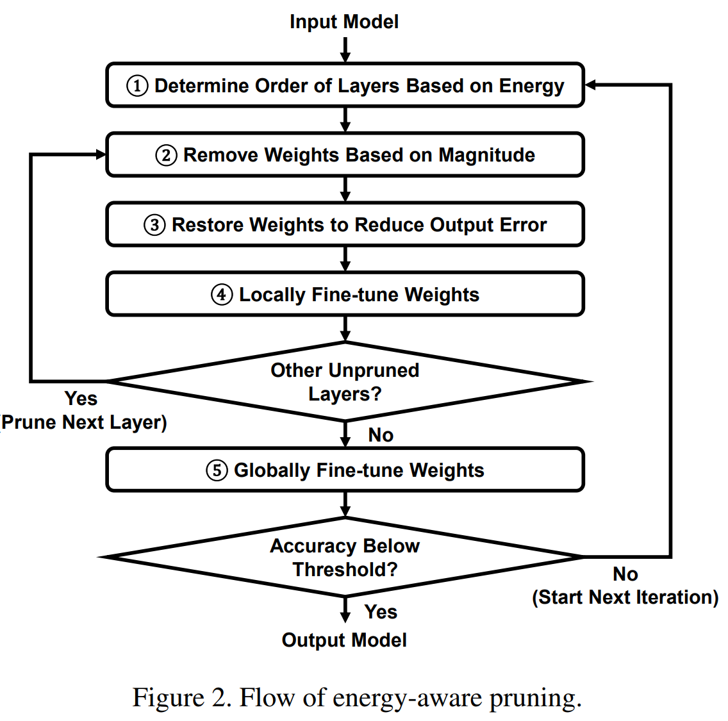
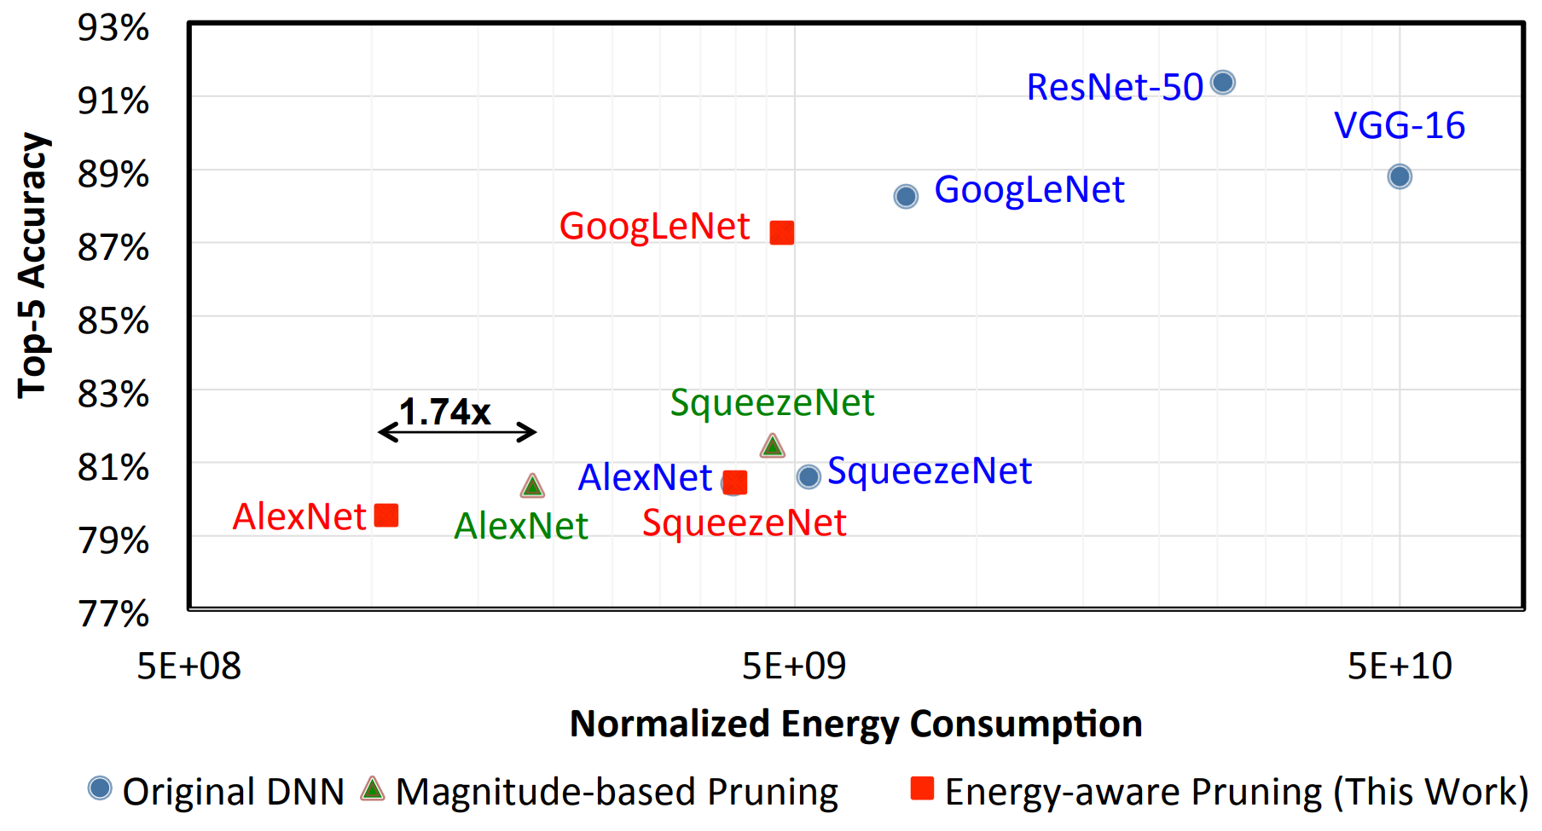
1.1Pruning – Make Weights Sparse
Method3：Energy-Aware Pruning
Energy-Aware Pruning
Energy-Aware Pruning Result
Remove weights from layers in order of highest to lowest energy 3.7x reduction in AlexNet / 1.6x reduction in GoogLeNet
Website: https://energyestimation.mit.edu/

Slide 7
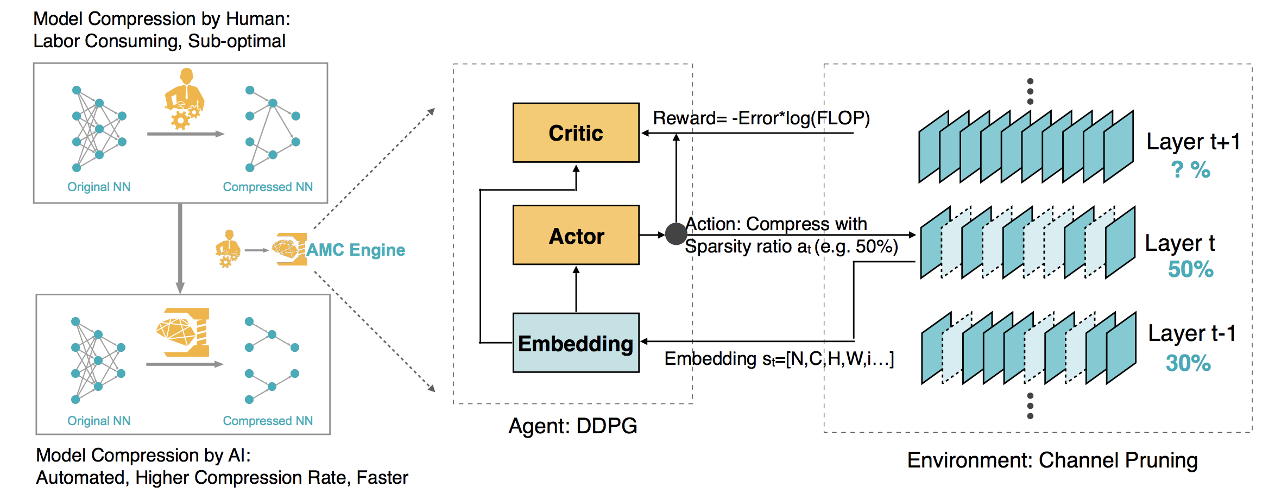
2.2 AutoML for Model Compression and Acceleration on Mobile Devices

Slide 8
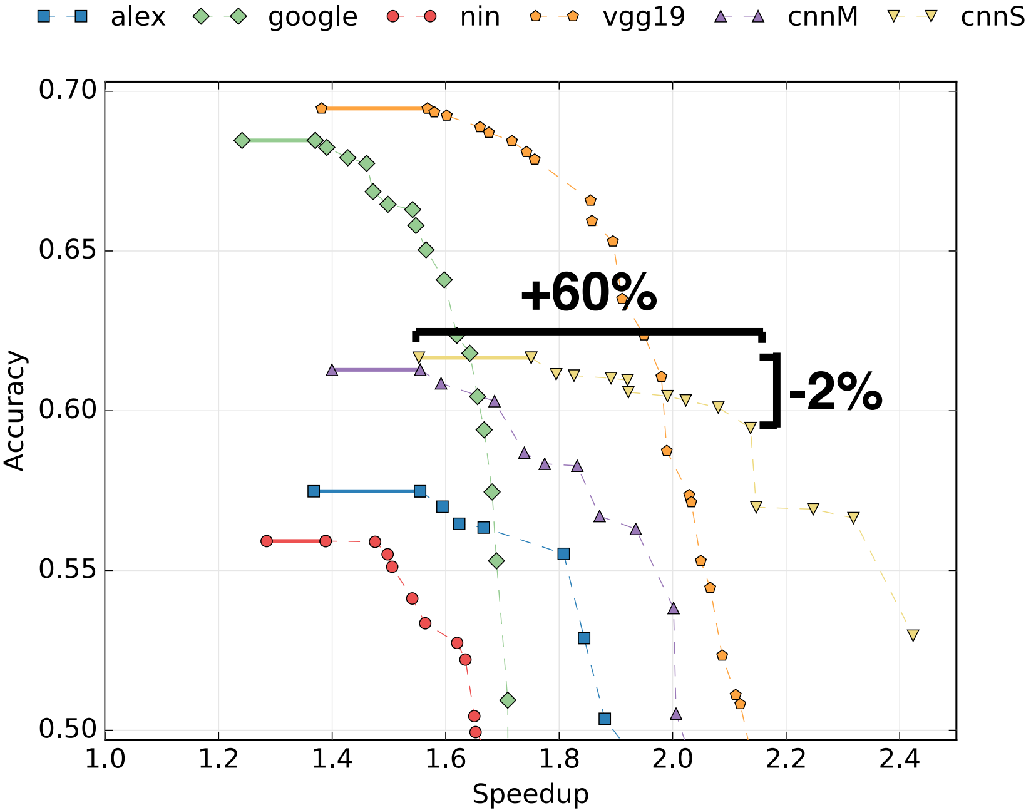
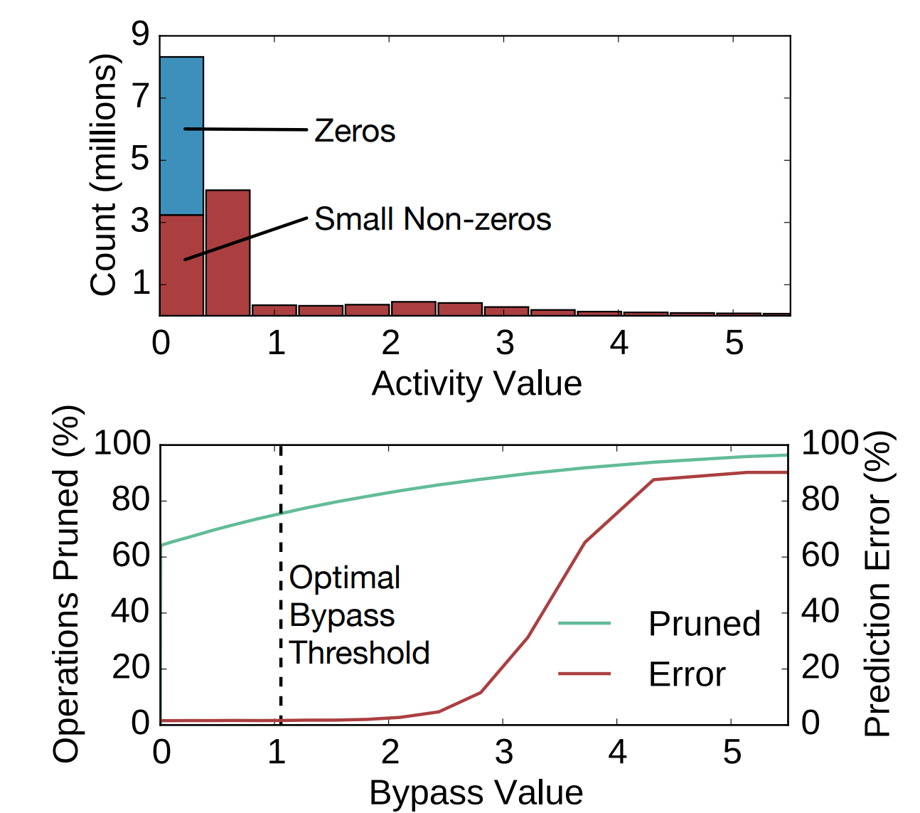
1.1Pruning activations
[Albericio et al., ISCA 2016]
[Reagen et al., ISCA 2016]

Slide 9
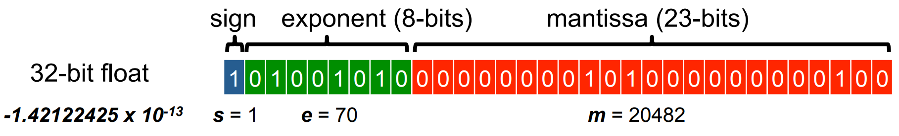
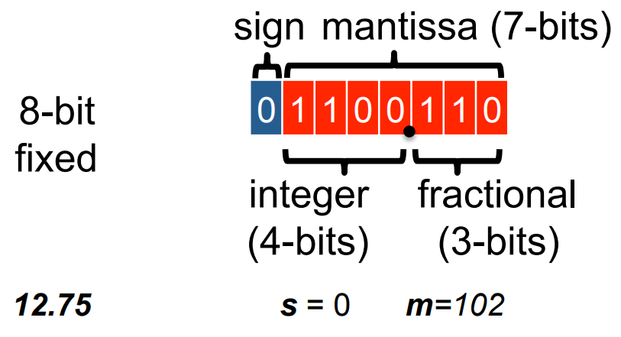
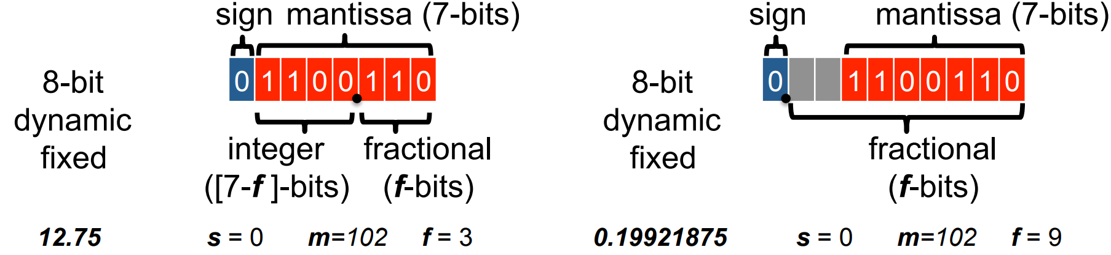
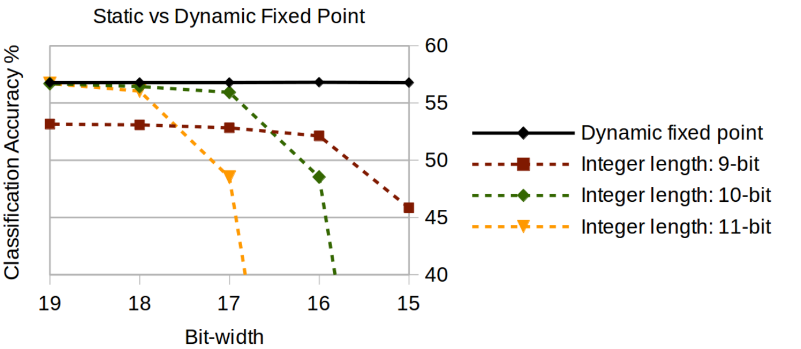
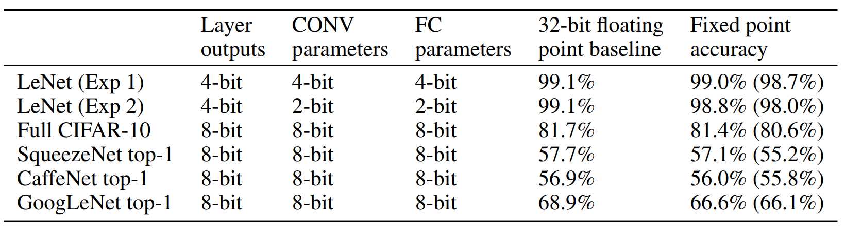
2.1 Floating point to Fixed point
Floating Point
Fixed Point
Dynamic Fixed Point
Top-1 accuracy on ImageNet(CaffeNet)
w/o fine-tune

Slide 10
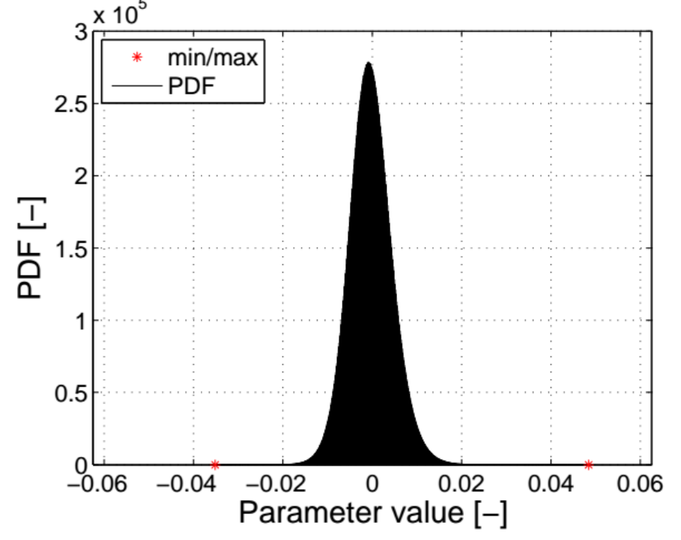
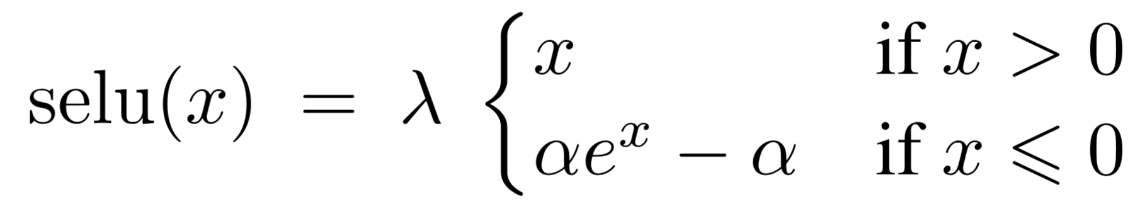
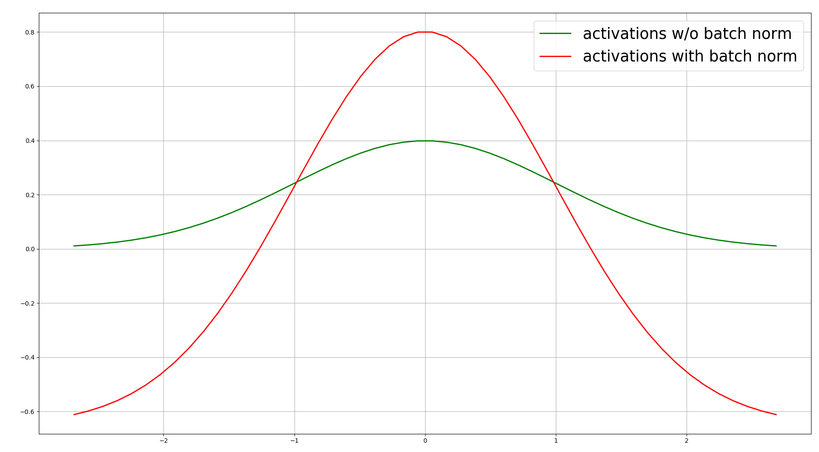
2.1 Floating point to Fixed point
Method to avoid dynamic fixed point
Lecun_norm + SeLU
origin | MNIST | CIFAR10 | ImageNet(AlexNet)
Tanh | 96.15 | 87.17 | 42.392/67.614
SeLU | 97.67 | 86.79 | 39.260/63.342
SeLU might cause the loss of accuracy
And gradient explosion
BN+ReLU >BN+SeLU>SeLU
Batch Norm

Slide 11
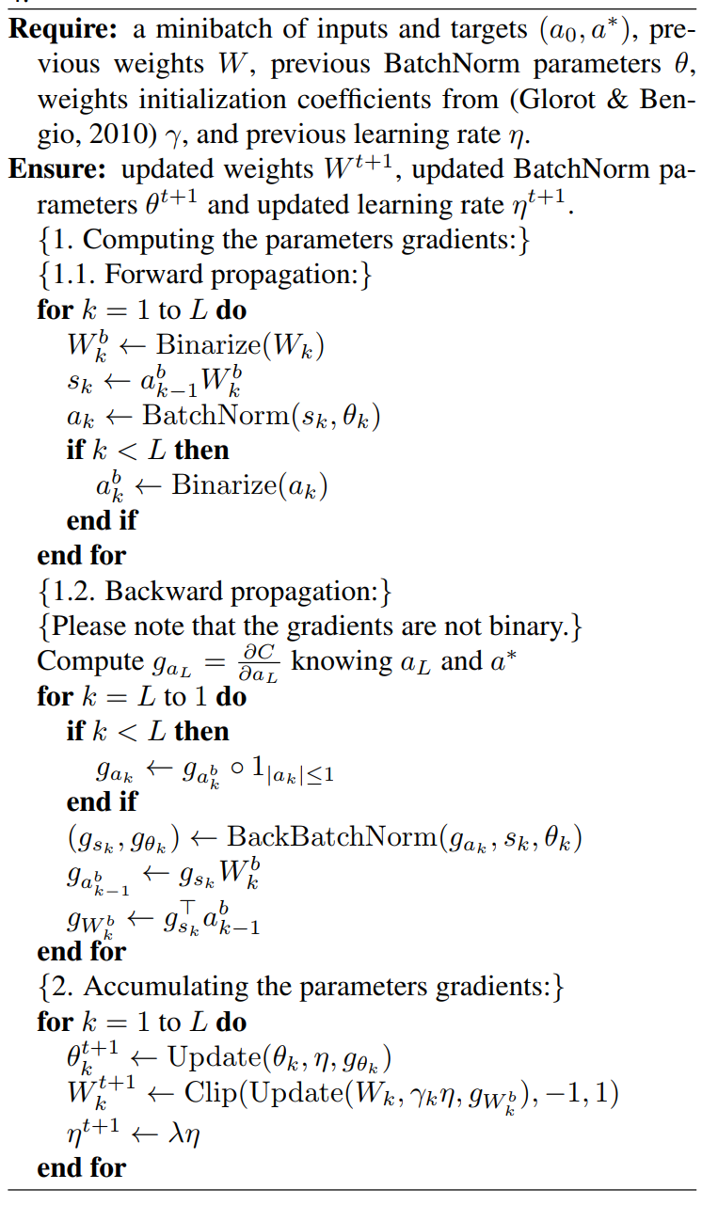
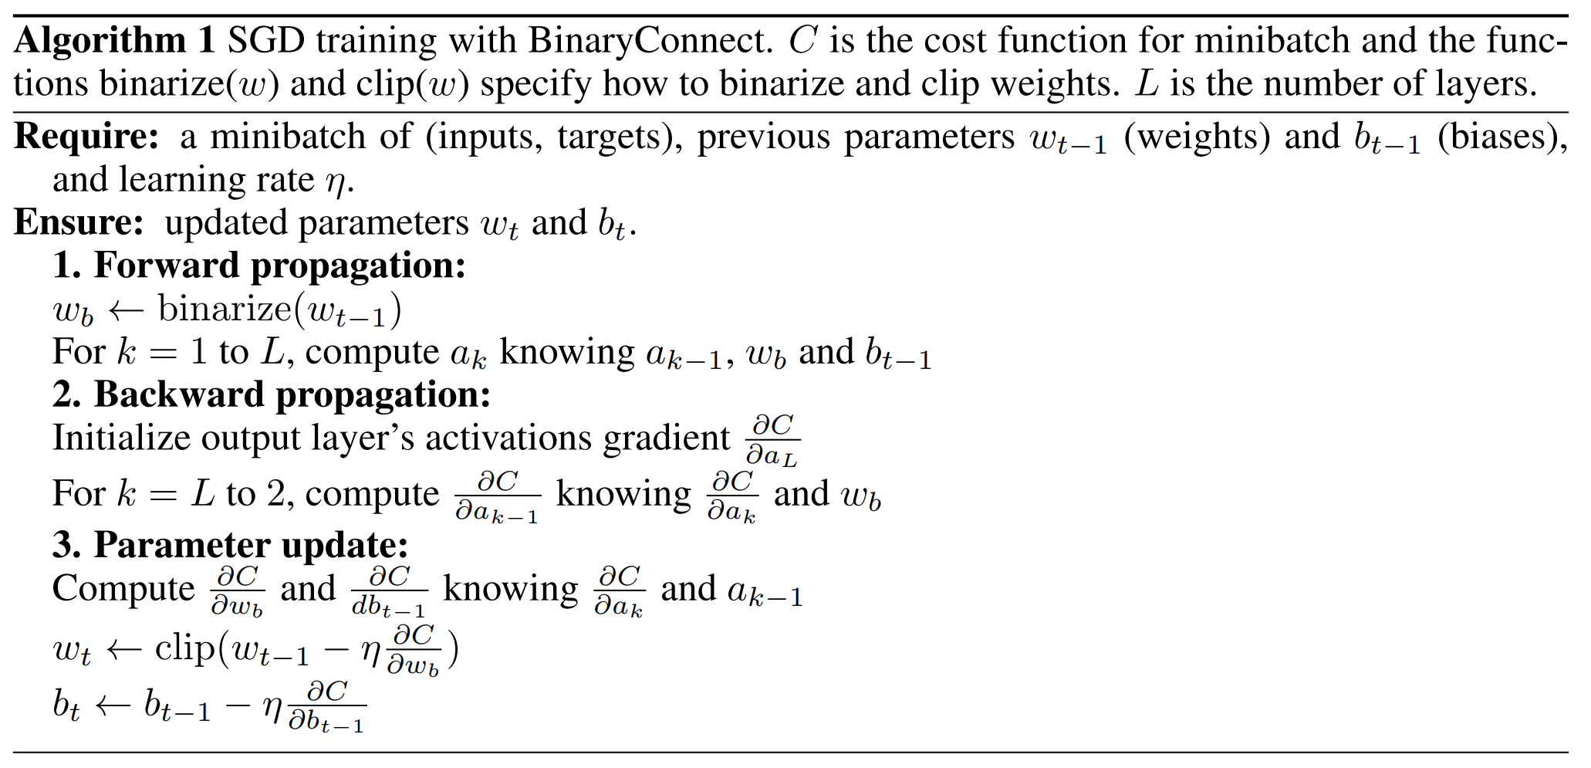
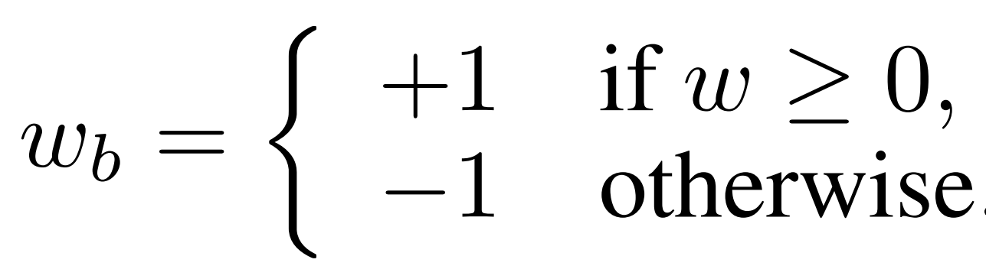
2.2 Bit-width reduction
Binary Nets
Weights {-1,1}, Activations 32-bit float
Accuracy loss: 19% on AlexNet
[Courbariaux, NIPS 2015]
Weights {-1,1}, Activations {-1,1}
Accuracy loss: 29.8% on AlexNet
[Courbariaux, arXiv 2016]

Slide 12
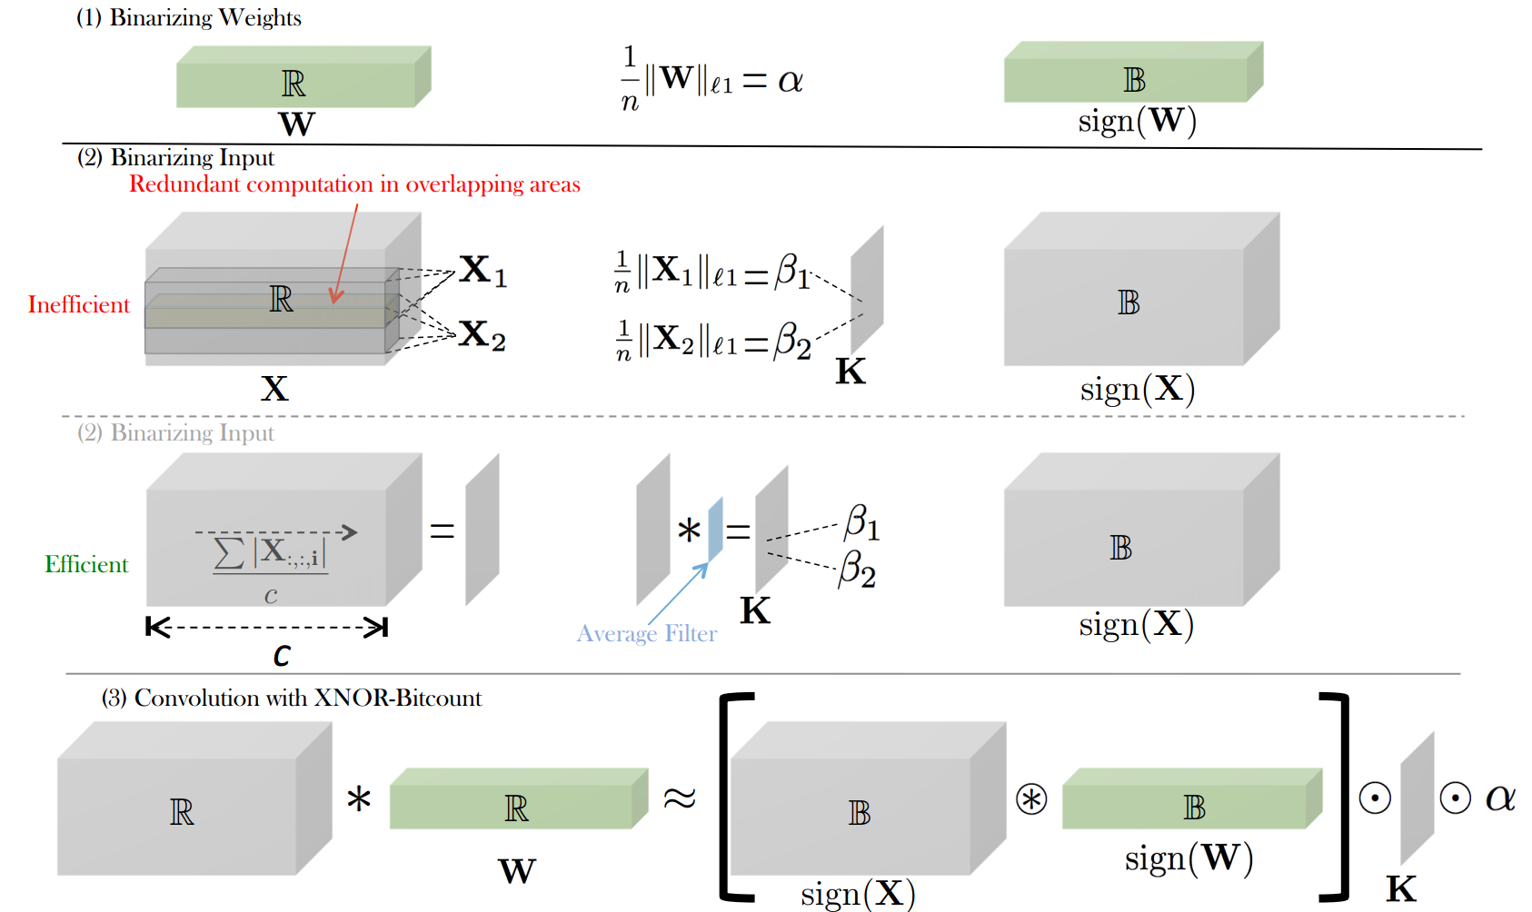
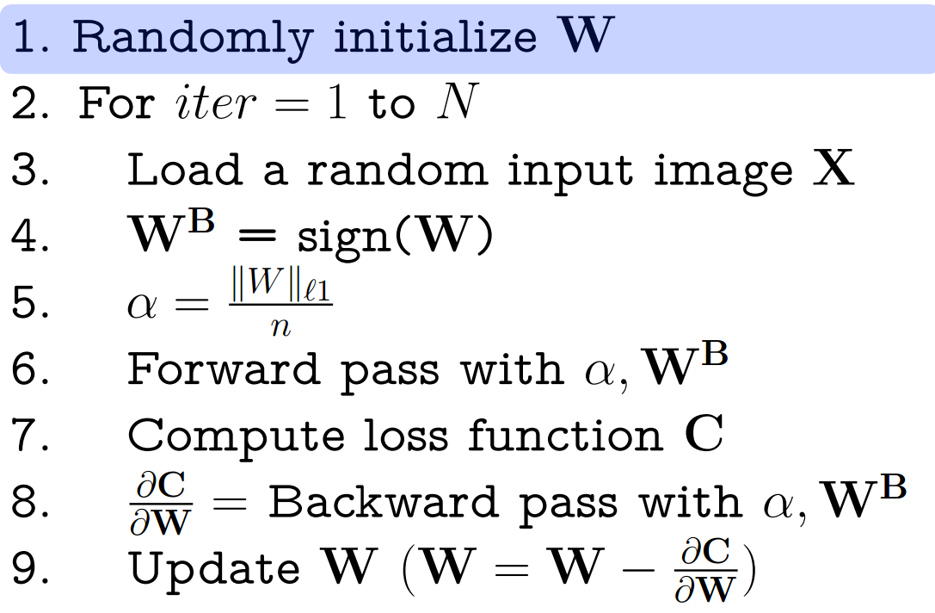
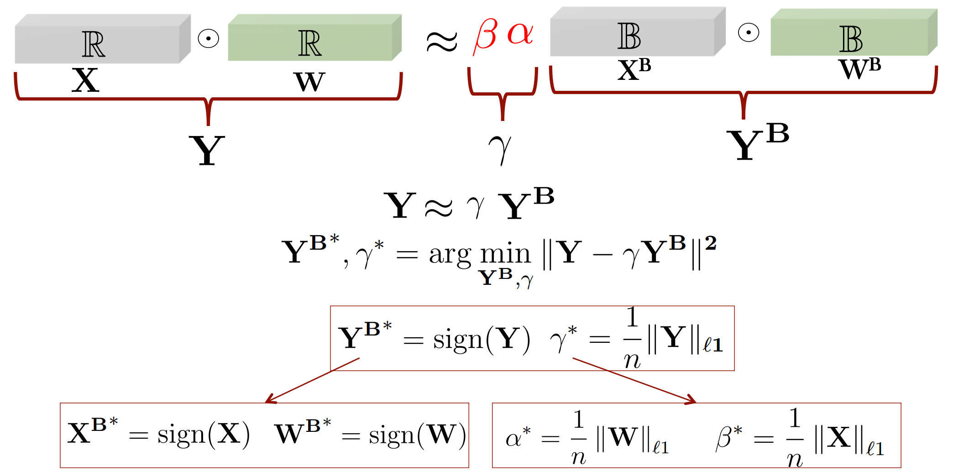
2.2 Bit-width reduction
Binary Nets
Weights {-α, α} Activations: 32-bit float α determined by the l1-norm of all weights in a layer , Accuracy loss: 0.8% on AlexNet
XNOR Net
Weights {-α, α} – Activations {-βi , βi } , βi determined by the l1-norm of all activations across channels for given position i of the input feature map , Accuracy loss: 11% on AlexNet

Slide 13
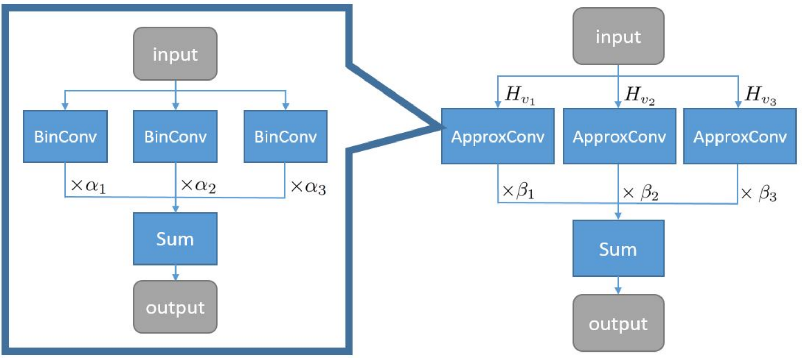
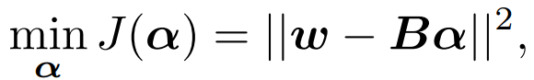
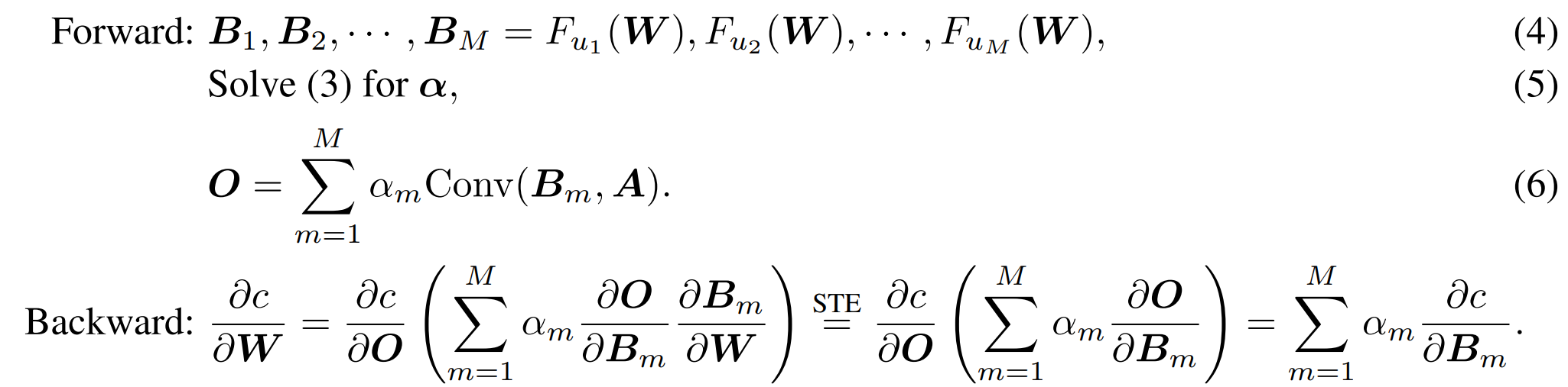
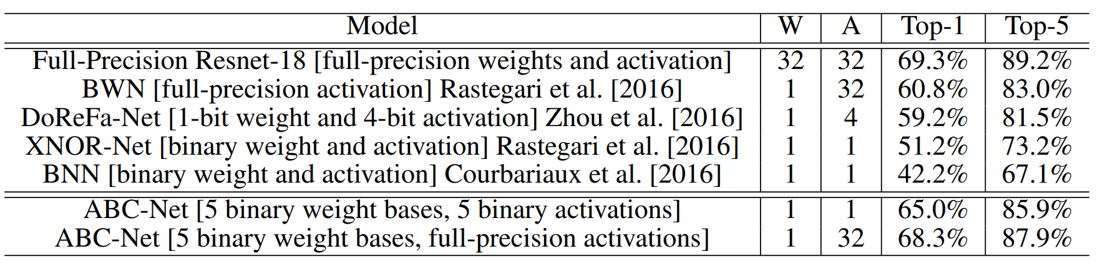
2.2 Bit-width reduction
Binary Nets
Towards Accurate Binary Convolutional Neural Network

Slide 14
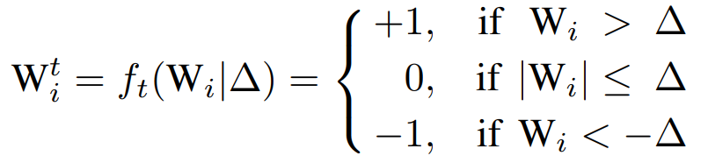
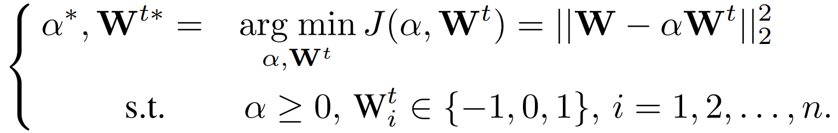
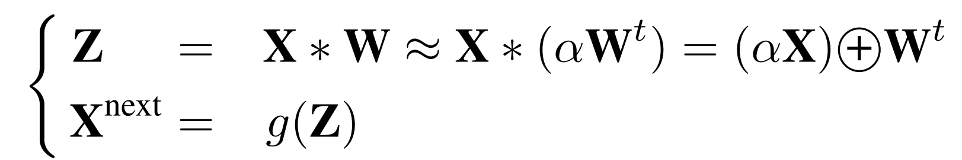
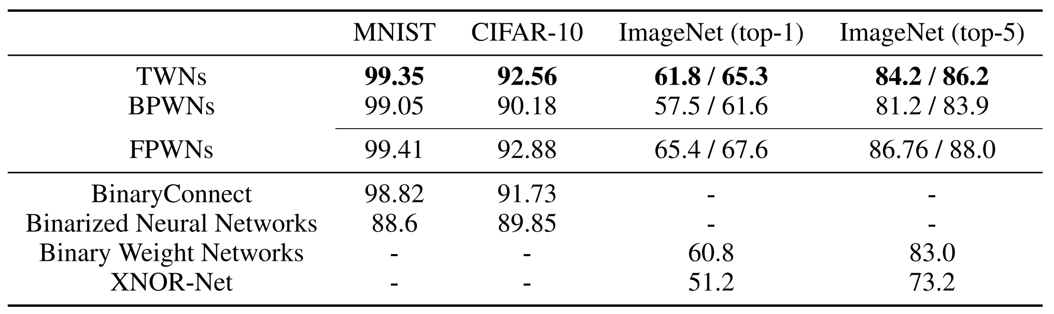
2.2 Bit-width reduction
Ternary Weight Network
Weights {-w, 0, w} except first and last layers are 32-bit float
Activations: 32-bit float Accuracy loss: 3.7% on AlexNet
[Li et al., arXiv 2016]

Slide 15
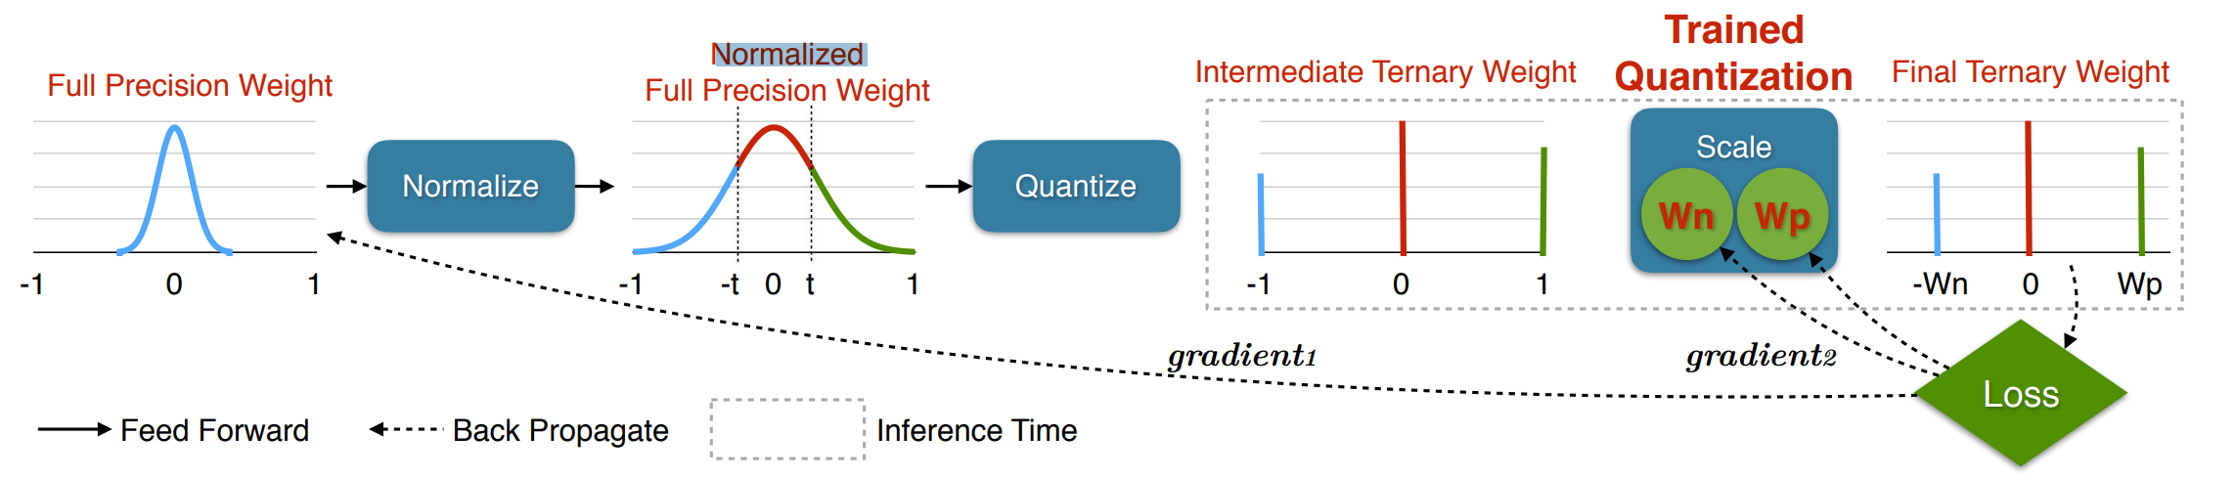
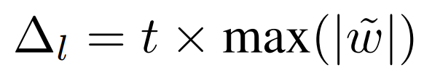
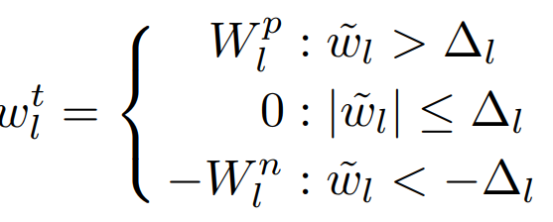
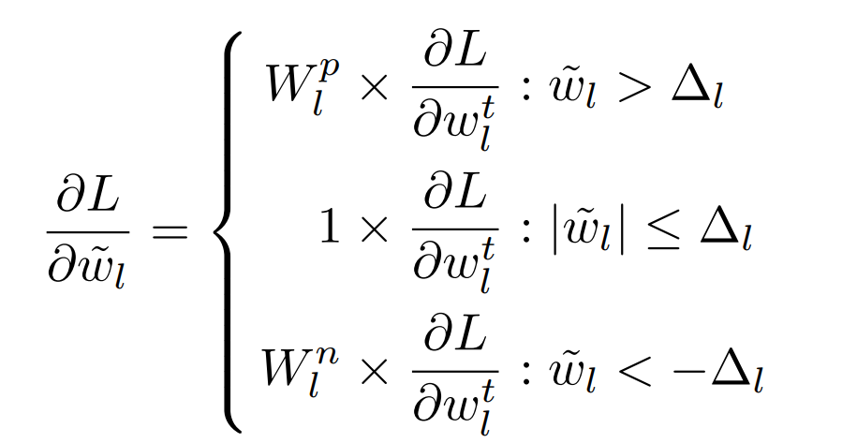
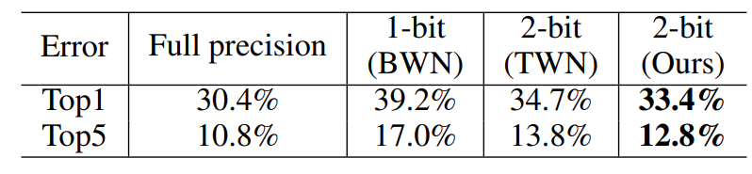
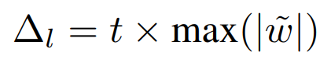
2.2 Bit-width reduction
Trained Ternary Quantization
Weights {-w1, 0, w2} Activations: 32-bit float
[Zhu et al., ICLR 2017]

Slide 16
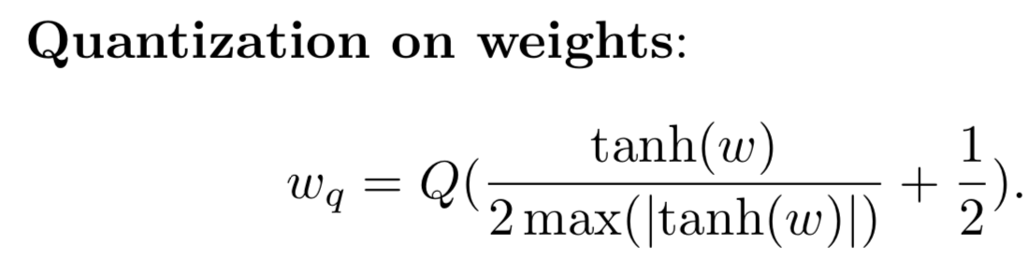
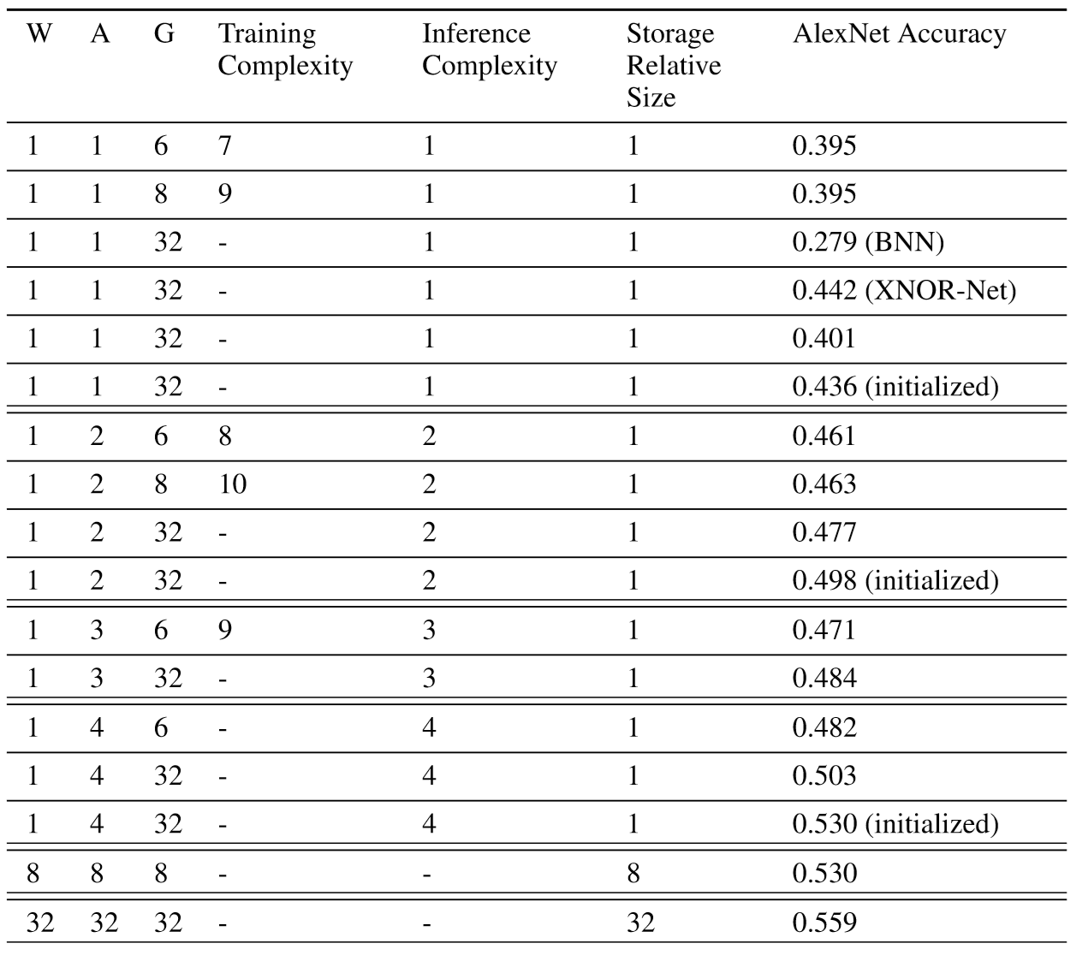
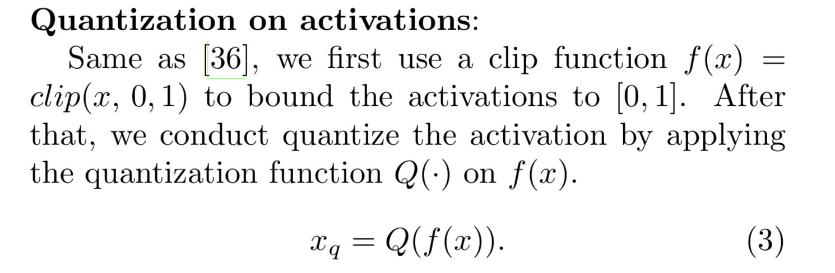
2.2 Bit-width reduction
DoRefa Net

Slide 17
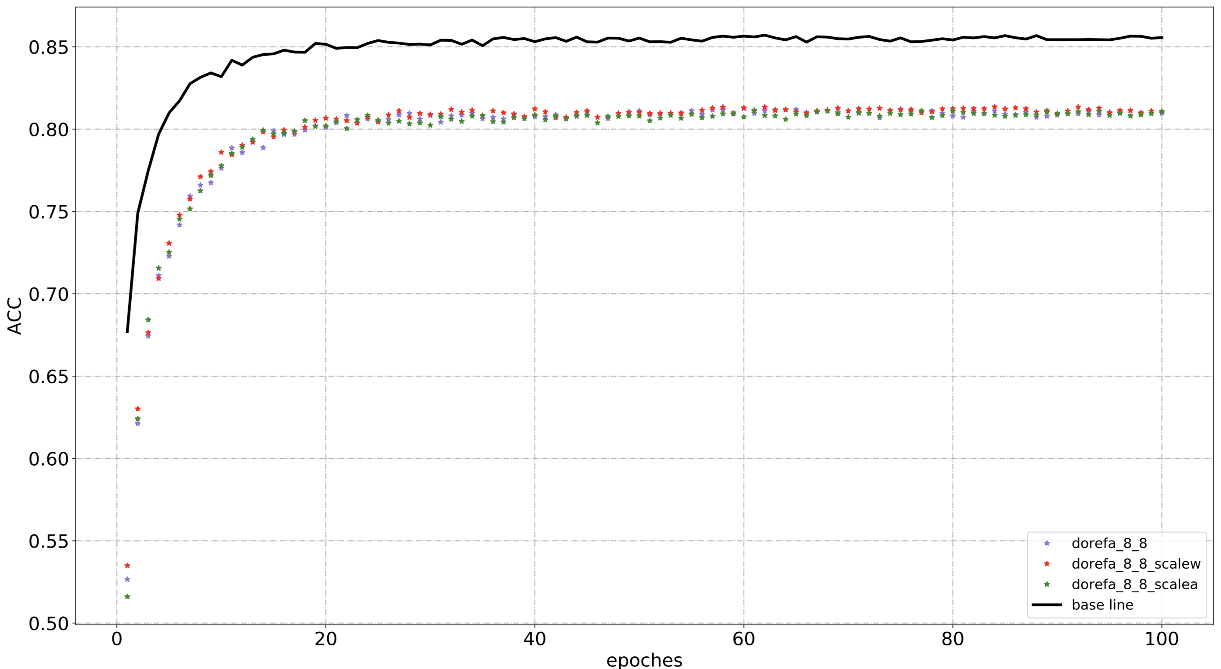
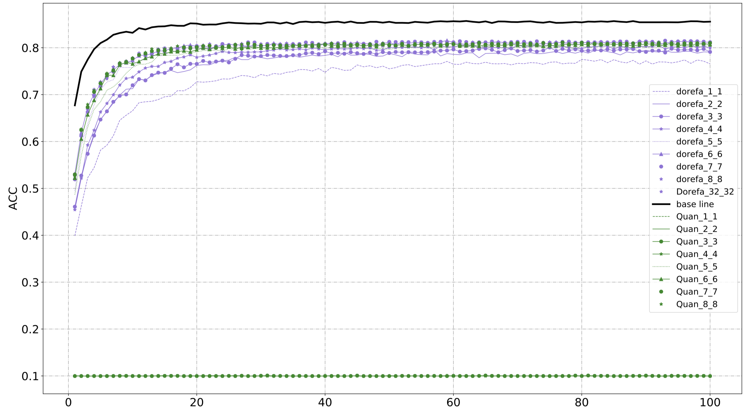
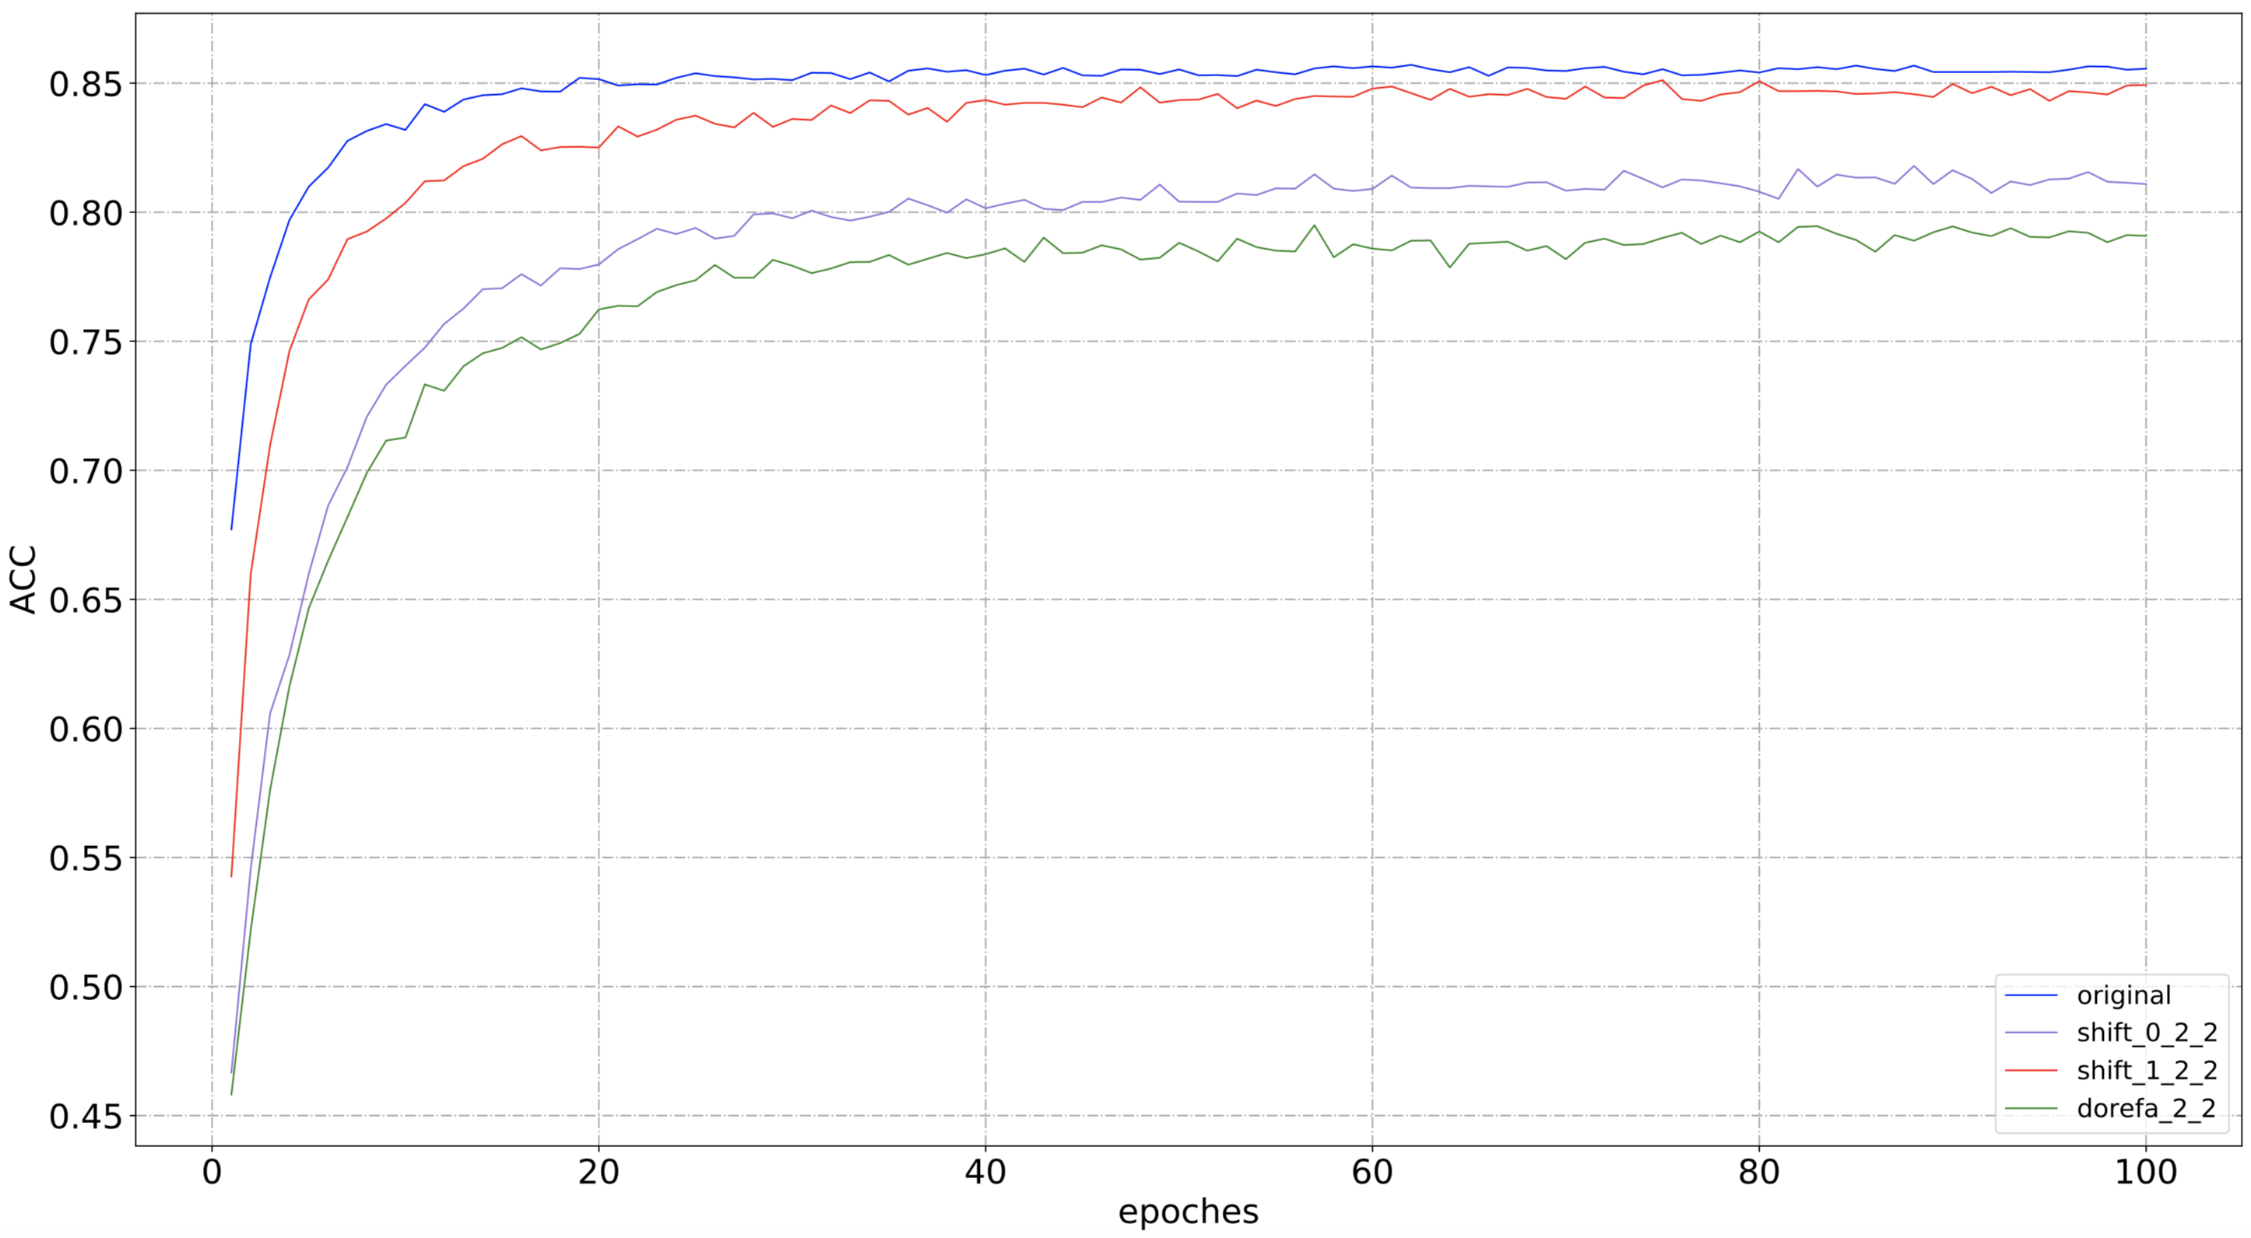
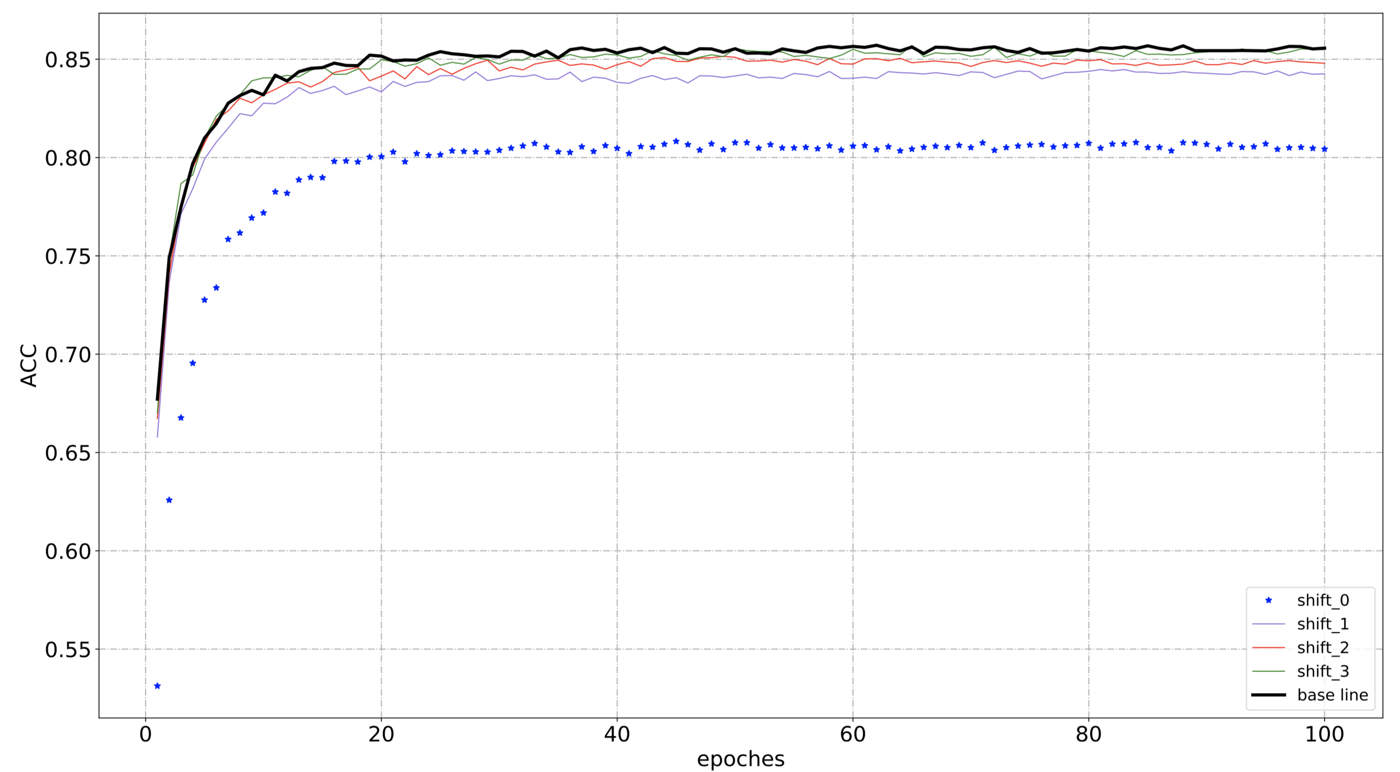
2.2 Some experiments to enhance the performance of
DoreFa-Net
A scale parameter is used to scale the distance between the quantified and original weights or activations but it did not make sense
Dorefa-Net bring a gap between compressed and original network
Scale parameter reduce the gap between the high bit and low bit.
A shift method is make sense

Slide 18



2.2 Quantization and Training of Neural Networks for Efficient Integer-Arithmetic-Only Inference(CVPR 2018)

Slide 19




2.2 Towards Effective Low-bitwidth Convolutional Neural
Networks(CVPR2018)
Algorithm1:16_16 -> 8_16
Algorithm2:32_32 ->16_16 –>8_8 –>6_6
Algorithm3:Reload the full-precision parameter
Using a full-precision network to get a guide L2-loss

Slide 20

2.2 diss
All for papers
Quantization Method | Testbench(ImageNet)
BCN | None
BNN | None
XNOR-Net | AlexNet
TWN | ResNet-18
QNN | AlexNet,CaffeNet,VGG-16,CNN-S
DoreFaNet | AlexNet
ABC-Net | ResNet-18
WAGE | AlexNet
TTQ | ResNet(20,32,44,56)
SYQ | AlexNet,ResNet18,ResNet-50
GQ(BN integrated). | ResNet(50,100,150),Inception v3,MobileNet
TEL-CNN | AlexNet
INQ | AlexNet,VGG-16,GoogleNet,ResNet-18,ResNet-50
Ours(BN integrated) | GoogleNet，ResNet-50，MobileNetV2， ShuffleNetV2
The quantization methods quality are related to the compact of network but almost all the quantization methods perform experiments on redundant network, but most networks on mobile end are compact networks.

Slide 21


2.2 AMC vs My quantization
AMC
Quantization

Slide 22


2.2 SnaPEA： Predictive Early Activation for Reducing Computation in Deep Convolutional Neural Networks

Slide 23



3.1 Application Scenarios
How Compressed algorithm’s used on Hardware?
Multiplication device
Go through ,zero skip , bit flip and XOR
Look up table

Slide 24
Thanks

